Slide 1
Granularity
Program – Desired
Program Instance – As it exists in nature: Source System
Sub Program – Desired

Slide 2
Source System: Program Instance Data:
Coverage Period 12/12 – 5/13
Assume Client at some point has previously had coverage in all three programs.
Program | Instance | Pri-AidCode | Sec-AidCode | Client | EligRun Date | Cov
Medicaid | 1 | 10 | 21 | Kevin | 11/30 | Y
Medicaid | 1 | 16 |  | Kevin | 11/30 | N
Medicaid | 2 | 34 | 39 | Kevin | 11/30 | Y
FoodStamps | 3 | 09 |  | Kevin | 11/30 | Y
AABD CASH | 4 | 55 |  | Kevin | 11/30 | N

Slide 3
Program: Grain of Program, Client, Month
Program | Client | Coverage Date | Coverage Count
Medicaid | Kevin | 12/12 | 1
Medicaid | Kevin | 1/13 | 1
Medicaid | Kevin | 2/13 | 1
Medicaid | Kevin | 3/13 | 1
Medicaid | Kevin | 4/13 | 1
Foodstamps | Kevin | 12/12 | 1
Foodstamps | Kevin | 1/13 | 1
Foodstamps | Kevin | 2/13 | 1
Foodstamps | Kevin | 3/13 | 1
Foodstamps | Kevin | 4/13 | 1
AABD Cash | Kevin | 12/12 | 0
AABD Cash | Kevin | 1/13 | 0
AABD Cash | Kevin | 2/13 | 0
AABD Cash | Kevin | 3/13 | 0
AABD Cash | Kevin | 4/13 | 0

Slide 4
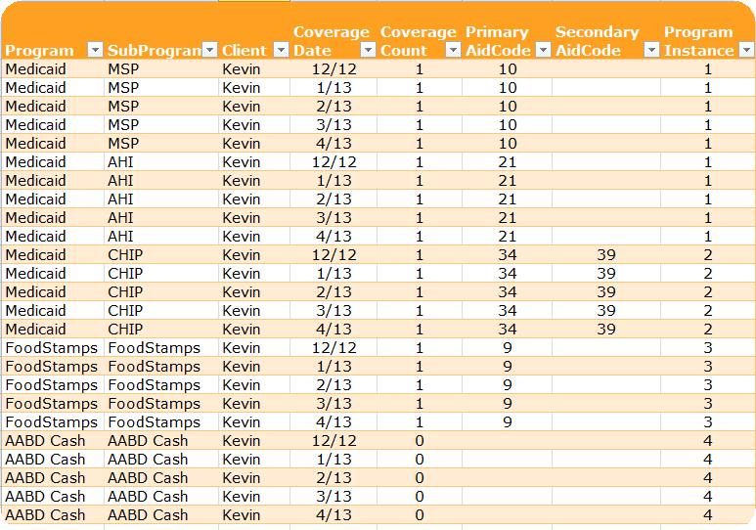
SubProgram: Grain of SubProgram, Client, Month

