Slide 1
International Outsourcing, Inc.
Workshop - November 10, 2012 Boise | Idaho
Data Warehouse / Business Intelligence Architecture Case Study
International Outsourcing, Inc. (IOI) is an Idaho Company specializing in improved Business Intelligence strategies, providing executives and decision-makers with the strategic information they need when they need it. Visit our website for more information on how we can help you improve your business intelligence. www.ioutsource.com

Slide 2
Welcome & Introductions
Event Coordinator – Laura Russell
Presenter - Kevin Herbert
Attendees
Mike | Barta | St. Lukes Health Systems
Dan | Brickey | Blue Cross of Idaho
Sarvani | Jagarlamudi | Idaho Department of Health & Welfare
Betsy | Mundell | Idaho Department of Health & Welfare
Jason | Picker | White Cloud Analytics
Introduce Yourself: Name and Company
List Two Job skills that are your Strengths
What do you hope to get out of this conference?
Notes:
Learn how the business works very quickly: See the big picture but also see all the little details and how they fit together
I would like to share some of the things I’ve learned over the years with my friends and colleagues, and I’m hoping to gain insight into the things I’ve done well and the things I’ve not done NOT so well so I can learn and grow as a person and Architect.

Slide 3
Agenda & Workshop Overview
Registration & Continental Breakfast 8:30 a.m.
Welcome & Introductions 9:00 a.m.
Agenda & Workshop Overview 9:15 a.m.
Workshop Session 1: Business Requirements, Goals and Analysis 9:30 a.m.
Lunch | On-Site Catering Provided 12:00 Noon
Workshop Session 2: Design 1:00 p.m.
Break | Snack Items Provided 2:45 p.m.
Workshop Session 3: Review Data Models 3:00 p.m.
Wrap-Up & Summary / Q&A 4:45 p.m.

Slide 4
Session 1
Business Requirements, Goals and Analysis
Agile Data Warehousing?
Agile BI – Apps, Dashboards, Scorecards, Reports?
Requirements Gathering
Understanding the Business
What, Why, When, How, Who
Project Goals
Corporate Objectives
Executive, Operational Manager, In the trenches Super User Perspectives
Analytics – What are the primary drivers, secondary drivers etc.
How Much is enough? Too much?
Where do you go from here?
Notes:
Build Production Ready DW part? In say 4 weeks.
Analytics – Gather all and request new
How Much – Not Big Bang

Slide 5
Session 1
Business Requirements, Goals and Analysis
Understand the Business Process you will be building a Data Warehouse on top of
Business Process Diagrams
Documentation
Live Demonstrations
Gain a conceptual understanding of the processes and systems
Common Ground
Taxonomies & Hierarchies
Analytical Inputs
From Source Documents
Create Complete list of analytics desired
Source System
Conceptual Data Model
Dev Team in House
Data Profiling
Entities and Attributes
Notes:
Walk though examples for understanding
Business Process – Manual web..
CDM
Common Ground – Terminology – Resistance – Treat it as an understanding tool – Business will see it as you have to define everything upfront
If you can’t agree on what something is having data in a repository isn’t very helpful.

Slide 6
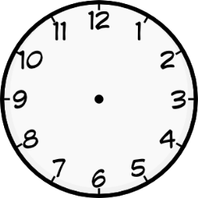
Break | Lunch
12:00 ~ 1:00

Slide 7
Session 2
Design of Data Model
Goals?
Understand Granularity of Facts
Mix or Match
What drives granularity in the dimensional model
Facts – Dimensions - Taxonomies
What Dimensional Challenges do you see coming
Pull together possible design choices for your most difficult problems
Where do Taxonomies and Hierarchies come from?
Resource Repository
Type 0, Type 1, Type 2, Type 3, Type 2 Contiguous
What are they
What do users want? What’s the impact?

Slide 8
Session 2
Design of Data Model
Bridge Tables
Primary
Outriggers
Thought Designs
Using a tool helps layout visually the tables
CDM
Entities and Attributes
Think about Type II’s Mostly
Analytical Requirements
If I were a User????
This is an iterative process

Slide 9
Break | Lunch
2:45 ~ 3:00

Slide 10
Session 3
Review Data Models
Review Thought Designs
Walkthrough the 7 Fact tables and what you see them as providing
What are the three lonely tables in the diagram?
Walk Through Dimensions
Walk Through Sub Program Coverage Star
Walk Through Sub Program ReEvaluation Schedule Star
Walk Through Sub Program Coverage Determination Star
What are the next steps
This Workshop has been all about understanding the business and designing an excellent Kimball Data Warehouse.
What about an EDW Framework for automation, quality, and yes innovation?

Slide 11
Wrap-Up & Summary
Early Bird Drawing & General Wrap-Up
Workshop Summary and Q&A

Slide 12
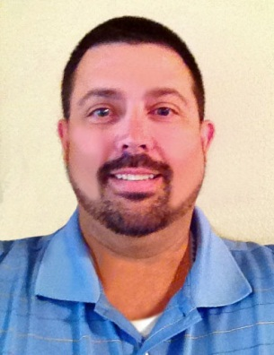
Close
Thank you for attending! We hope you found today’s workshop to be useful in refining your overall concept of business intelligence and data warehouse design as well as providing an opportunity to work through hands-on data modeling for real-time project success. Workshop materials are available for a limited time at www.ioutsource.com for your use and are downloadable.
I would welcome the opportunity to work with you and your organization(s) in the future to improve your business outcomes by leveraging the power of data as a strategic tool.
Contact me at kevin@ioutsource.com or
by phone at (208) 870-7174.
This event has been coordinated by Bloomin’ Events Treasure Valley. Contact Laura Russell with Bloomin’ Events for your future event support needs at (208) 921-9247.
International Outsourcing, Inc. (IOI) is an Idaho Company specializing in improved Business Intelligence strategies, providing executives and decision-makers with the strategic information they need when they need it. Visit our website for more information on how we can help you improve your business intelligence. www.ioutsource.com

